Slide 1
“Adding To Your Faith”
(Part 1)
2 Peter 1:8
“For if these things are yours and abound, you will be neither barren nor unfruitful in the knowledge of our Lord Jesus Christ.”
2 Peter 1:1-11

Slide 2
Recognize the need to grow –
Have a desire to grow –
Acknowledge a need for assistance to grow
MOST of us
2 Peter 1:1-11

Slide 3
Spiritual growth is a divine requirement for every believer - (We are free moral agents)
The Word of God is the divine provision for spiritual growth.
We never stay the same – we are either growing spiritually – or we are growing weaker!
2 Peter 1:1-11

Slide 4
2 Peter 1:1-3
“Simon Peter, a bondservant and apostle of Jesus Christ, To those who have obtained like precious faith with us by the righteousness of our God and Savior Jesus Christ:
Grace and peace be multiplied to you in the knowledge of God and of Jesus our Lord as His divine power has given to us all things that pertain to life and godliness, through the knowledge of Him who called us by glory and virtue.”

Slide 5
2 Peter 1:4-6
“By which have been given to us exceedingly great and precious promises, that through these you may be partakers of the divine nature, having escaped the corruption that is in the world through lust.
But also for this very reason, giving all diligence, add to your faith virtue, to virtue knowledge,
to knowledge self-control, to self-control perseverance, to perseverance godliness.”

Slide 6
2 Peter 1:7-9
“To godliness brotherly kindness, and to brotherly kindness love.
For if these things are yours and abound, you will be neither barren nor unfruitful in the knowledge of our Lord Jesus Christ. For he who lacks these things is shortsighted, even to blindness, and has forgotten that he was cleansed from his old sins.”

Slide 7
2 Peter 1:10-11
“Therefore, brethren, be even more diligent to make your call and election sure, for if you do these things you will never stumble; for so an entrance will be supplied to you abundantly into the everlasting kingdom of our Lord and Savior Jesus Christ.”

Slide 8
God has given us what we need to grow into fruitful Christians – (1:1-4)
Great effort is required on our part in order to be fruitful Christians – (1:5,10)
The reward - security and entrance into God’s everlasting kingdom – (1:8,11)
If we fail to grow we will fall and be in danger of being eternally lost – (1:9; 2:20-22)

Slide 9
Giving All Diligence
Diligence – Hebrews 6:11; 2 Peter 1:5,10
Purpose – Mature Christians do not just happen - they are made – Joshua 24:15; Matthew 6:33

Slide 10
Giving All Diligence
Diligence – Hebrews 6:11; 2 Peter 1:5,10
Commitment – Can’t be double minded - 1 Kings 18:21; Acts 11:23
Continued pursuit – No shortcuts - Takes time, great effort and patience – 1 Corinthians 15:58; Colossians 1:23

Slide 11
Add To – ἐπιχορηγέω - epichorēgeō
To supply, furnish, to minister unto – [Vine; Thayer; BDAG] - 1:11; 2 Corinthians 9:10; Galatians 3:5; Colossians 2:19
The verb rendered add (ἐπιχορηγήσατε) is derived from χορός a chorus, … The verb originally means to bear the expense of a chorus … In the NT sense of supplying or providing.

Slide 12
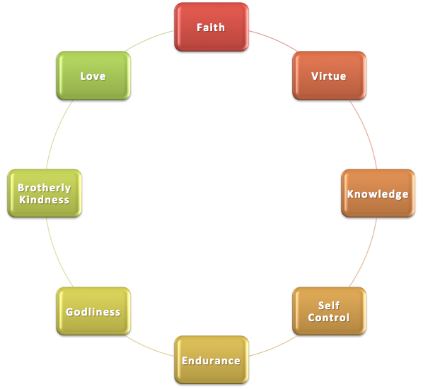
2 Peter 1:5-10 ⁵ giving all diligence, add to your … ¹⁰ Therefore, brethren, be even more diligent to make your call and election sure,

Slide 13
Add To Your Faith – Hebrews 11:1; Romans 10:17
Faith is the foundation - Hebrews 11:1, 6
Faith is the motivation – 2 Corinthians 5:7; Galatians 2:20
Faith should grow – Luke 17:5; 2 Thessalonians 1:3; Romans 10:17

Slide 14
2 Peter 1:5-10 ⁵ giving all diligence, add to your … ¹⁰ Therefore, brethren, be even more diligent to make your call and election sure,

Slide 15
Add Virtue – 2 Peter 1:3; Philippians 4:8
Defined as moral excellence - Moral power, moral energy, vigor of soul (Bengel)
“Bring the finest character to your commitment” [BDAG]
A holy nation - called out of darkness into light - 1 Peter 2:9

